Slide 1
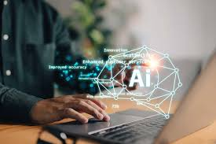
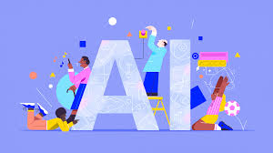
INTRODUCTION TO ARTIFICIAL INTELLIGENCE (AI)

Slide 2
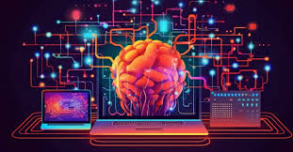
Artificial intelligence (AI) refers to computer systems capable of performing complex tasks that historically only a human could do, such as reasoning, making decisions, or solving problems.
It is the theory and development of computer systems capable of performing tasks that historically required human intelligence, such as recognizing speech, making decisions, and identifying patterns.

Slide 3
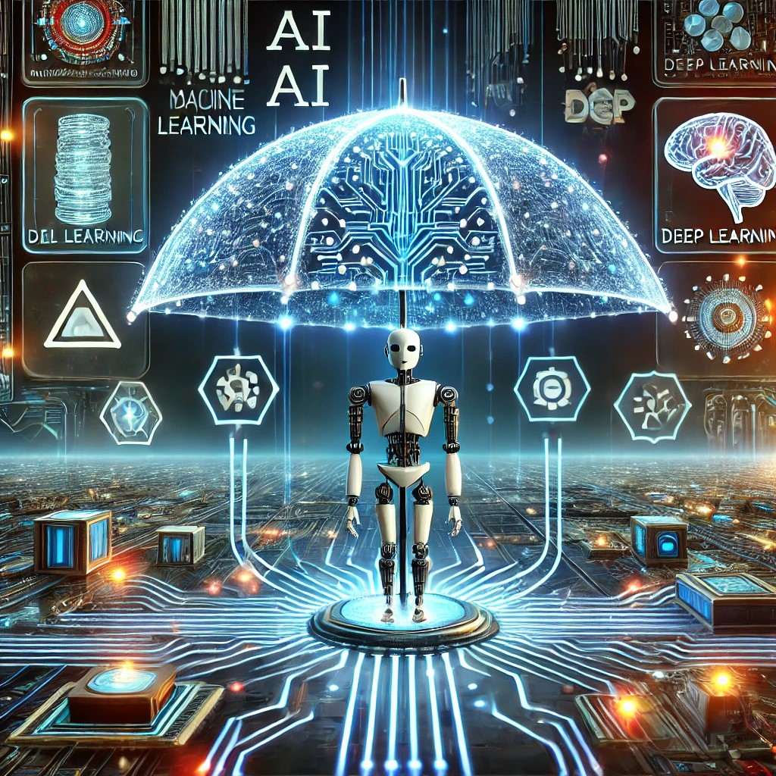
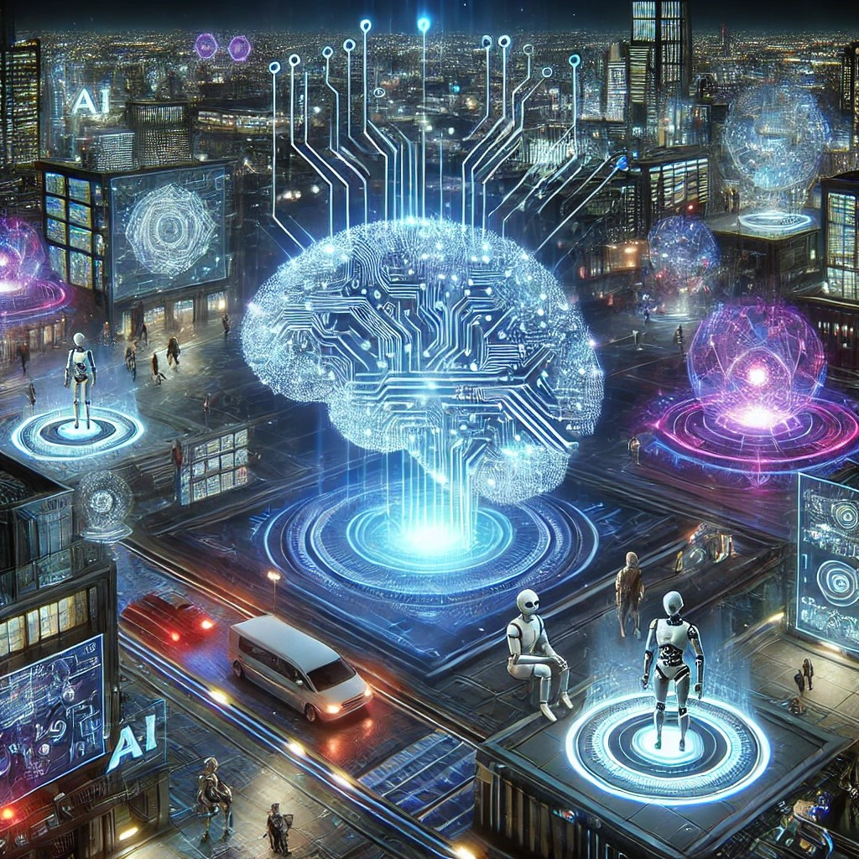
AI is an umbrella term that encompasses a wide variety of technologies, including machine learning, deep learning, and natural language processing (NLP).

Slide 4
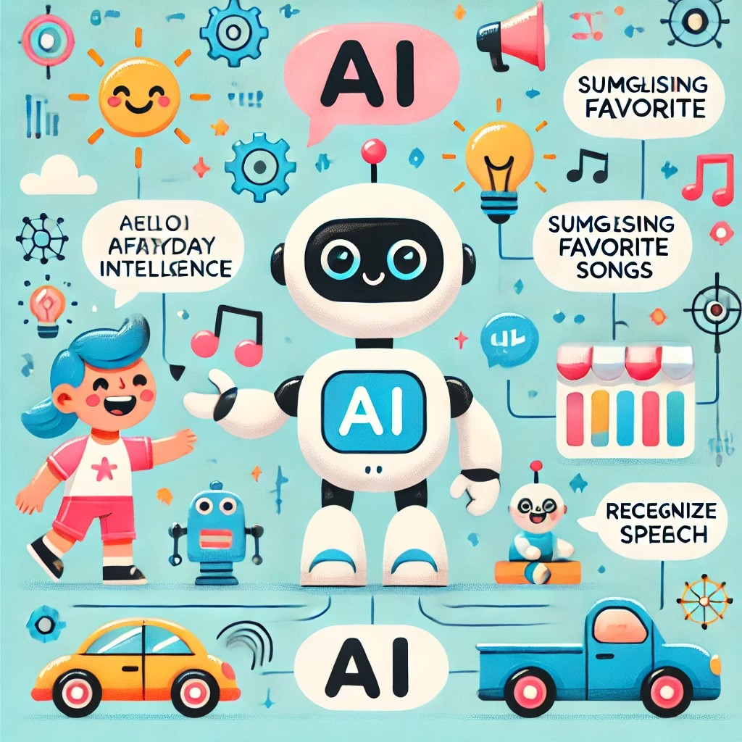
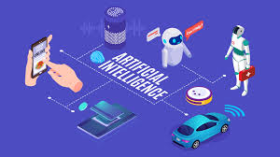
AI involves creating computer programs that can solve problems, make decisions, and improve over time. These smart programs can analyze data, recognize patterns, and adapt to new information. Whether it’s a self-driving car or a personalized recommendation on YouTube, AI is all about making our lives easier and more exciting by mimicking human intelligence.

Slide 5

TYPES OF AI
AI comes in different types:
Narrow AI: Specialized for specific tasks, like facial recognition or music recommendations.
General AI: Human-like intelligence that can learn and apply knowledge across various tasks (not yet achieved).
Super AI: A hypothetical AI surpassing human intelligence, excelling in all intellectual tasks.

Slide 6
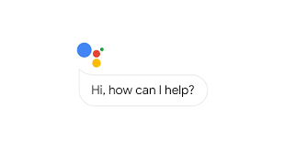
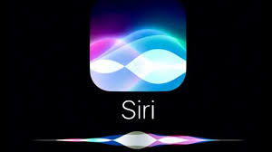
DAILY LIFE USES OF AI
Digital assistants
If you have a smartphone or laptop, you probably have and use digital assistant software to some degree.
Some of the most popular digital assistants include:
Siri (Apple)
Alexa (Amazon)
Cortana (Microsoft)
Google Assistant (Google)
Bixby (Samsung)

Slide 7

Search engines
AI powers search engines by refining results and predicting queries. Features like "People also ask" and auto-complete rely on AI to enhance user experience.
Popular search engines include:
Google
Yahoo

Slide 8



Social media
Social media platforms use AI to personalize content and collect user data for ads, keeping users engaged.
You can train your social media algorithms to show the content you like by creating filters, or searching carefully for what you like, and purposefully interacting (liking, commenting, sharing, etc.) with things you enjoy.
Popular social media platforms include:
Facebook (Meta)
Instagram (Meta)
YouTube
TikTok

Slide 9
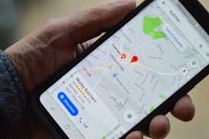
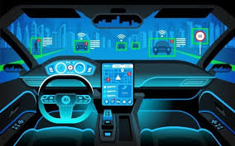
AI improves transportation through self-driving cars, traffic-based navigation, and autopilot in aircraft. It enhances safety, efficiency, and reliability.

Slide 10

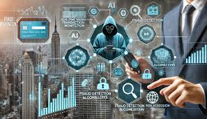
Fraud prevention
Banks use AI to detect and prevent fraud by analyzing transactions and spotting unusual activity. If something looks suspicious, AI can block the transaction and alert you for verification.

